Slide 1
The overview of text-to-speech (TTS) and database collection

Slide 2
Motivation
It is interesting to build a dialogue system
It is more convenient to label speech database manually by TTS function
What database we need for TTS ?
What is the difference between ASR and TTS in collecting database?

Slide 3
Reference
D. Burileanu, A. Neagu and C. Burileanu, “Diphone database development for a Romanian language TTS system”, State of the Art in Speech Synthesis (Ref. No. 2000/058), IEE Seminar on , 13 April 2000.
J. Kominek and A. Black, “CMU Arctic database for speech synthesis” , http://www.festvox.org/cmu_arctic , 2003.
L. Rabiner and B. H. Juang, “fundamentals of speech recognition” , Prentice Hall 1993.

Slide 4
Goal of this Talk
Survey of database design and overview for TTS
  Douglas O’Shaughnessy, “Iterating with computers by voice: automatic speech recognition and synthesis”, Proceedings of the IEEE , Sep 2003.
Survey of speech database automatic labeling
  M. Boldea, C. Munteanu, A. Doroga, “Design, collection, and Annotation of a Romanian Speech Database”, 1998.
  M. Boldea, C. Munteanu, “Labeling a Romanian speech database”, In Proceedings of the Second International Workshop "Speech and Computer" - SPECOM'97, Cluj-Napoca, 1997.
An idea for speech validation and recent work results

Slide 5
Outline
Introduction
The overview of TTS
  Basic concatenation approaches
  Choice unit
  Spectral method for TTS
  Waveform method for TTS
  Text processing for TTS
Database collection associated with TTS
  CMU Arctic databases for TTS
  Diphone Database collection for TTS in Romanian
Speech database automatic labeling
Recent work results
Summary

Slide 6
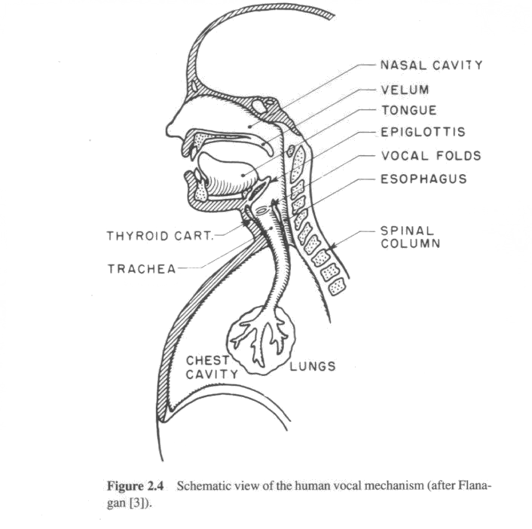
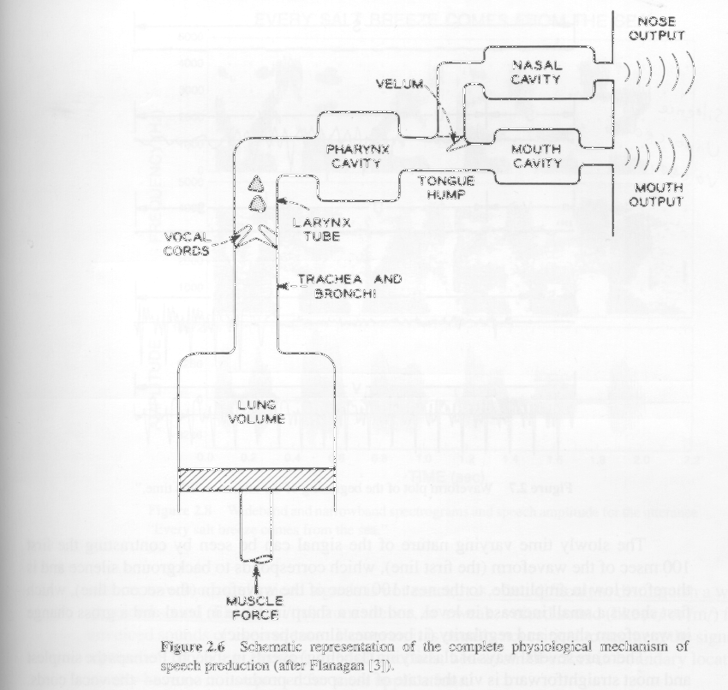
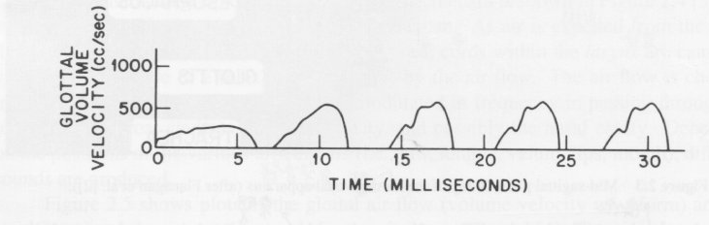
Introduction
TTS simulates the vocal tract (VT) as automatic speech recognition (ASR) model the ear
F0 (pitch)

Slide 7
Introduction (cont.)
While minimizing costs (computer memory, computation, etc) the quality of TTS is measured
  Intelligibility
  Naturalness→ major challenge
Database design has been a major area of recent TTS research

Slide 8
Basic concatenation approaches
Spectral method
  Spectral feature for phoneme
  Simulation coarticulation
  Digital filter ( which simulates the spectral effects of the VT)
Waveform method
  Storage of very large number of speech units
  Usually, the resulting speech was discontinuous
  Small-unit TTS requires minimal storage, but provides less natural output speech unit

Slide 9
Choice unit
In English
  50K common words( most speakers use only a few thousand, but vocabularies vary greatly for different speakers
  Diphone is good choice because the number of unit is about 40*40=1600. It is still very feasible
  Syllables have occasionally been suggested as TTS units, but English needs about 10K syllables
In Taiwanese
  Syllable is good choice, because the number of syllable is about 800

Slide 10
Spectral method for TTS
Formant synthesis
  1965-1995
  A set of parameters characterizing the short-time spectral envelope (VT filter) is stored for each units
  The excitation is often either a periodic train of pulse or white noise
  The four lowest center frequencies of the formant (i.e., F1 to F4) vary dynamically from frame to frame

Slide 11
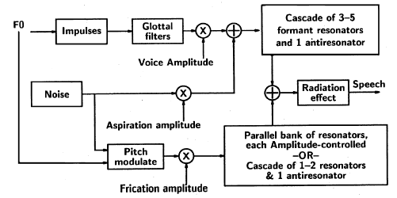
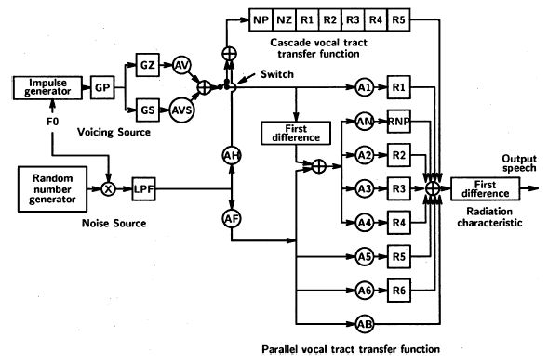
Spectral method for TTS(cont.)

Slide 12
Waveform method for TTS
Waveform TTS requires much more computational resources than spectral approaches
  Amplitude modulation
    Humans normally control amplitude more globally than on phonemes when concatenating subsyllable units

Slide 13
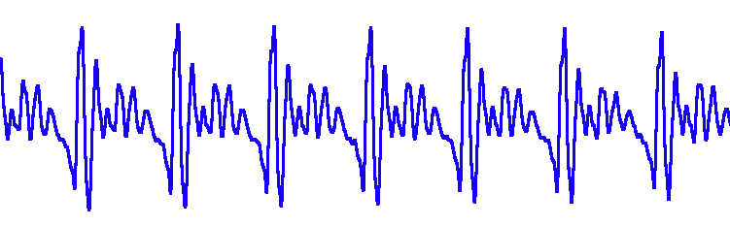
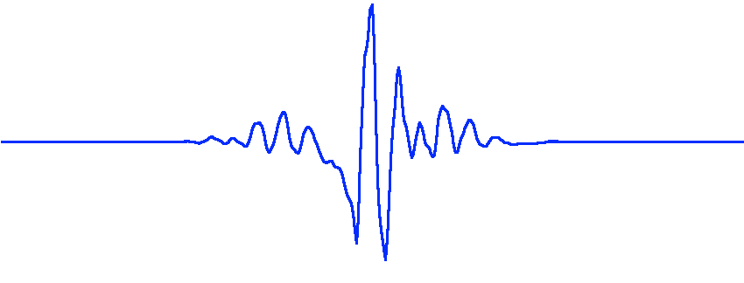
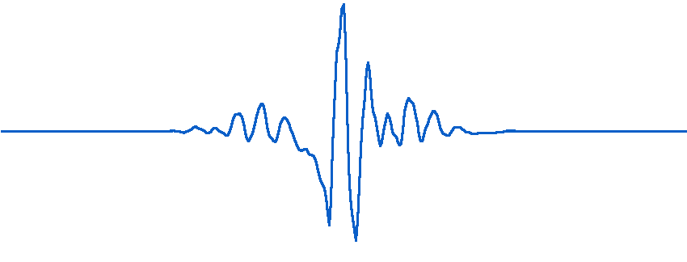
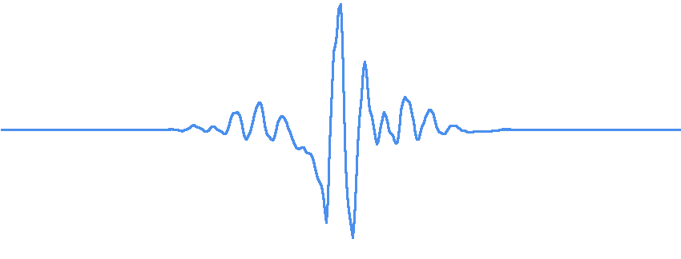
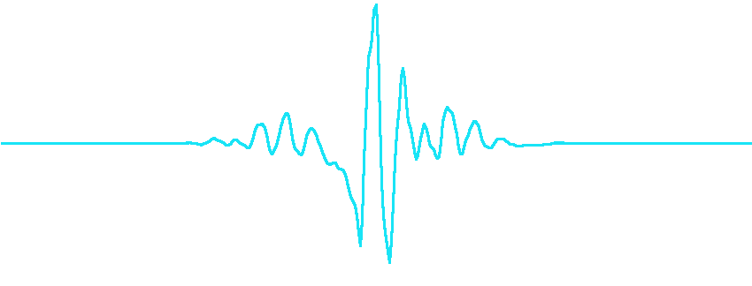
Waveform method for TTS (cont.)
  Pitch period (F0)
    PSOLA
降低音高
升高音高
增加時長
縮短時長

Slide 14
Waveform method for TTS (cont.)
  Other finer aspects of the stored units
    Continuity ( both spectral amplitude and phase) at unit boundaries
    Take a example latter (Burileanu 2000)
TTS database or corpora
  The quality of TTS is often proportional to the size and number of the speech units in TTS database
    Diphone units (Kominek 2003)
    Record the chosen speaker in many recording sessions, but select only desirable units

Slide 15
Waveform method for TTS (cont.)
  The other key area of TTS database
    How to select the appropriate unit from a large corpus
    What adjustments to perform at “join” boundaries
    Burileanu 2000
Automatic unit selection for waveform TTS
  Key idea: choose the proper speech unit at runtime and that of joining successive units
  The first task is more difficult, including corpus design and database design
  How to minimize costs

Slide 16
Text processing for TTS
Text processing is initial step of TTS
  Key concept: Transform text to a representation allowing access to the stored units in the speech database
  The proper units in multilingual TTS
    Minor articulator and acoustic differences across language in phoneme → Formant-based TTS can be more easily modified than waveform concatenation
  Errors in modern TTS systems seem to be limited to names and foreign words

Slide 17


The MSP TTS system
將書寫形式的文字轉變成口語形式的拼音，例如：〝今天〞變成〝gin2-a1-rit8〞
所需技術及資源
文字分析、自然語言處理、辭典
針對某些語句產生自然的韻律參數，例如：基頻( Pitch )參數、時長 ( Duration )參數等。
所需技術及資源
變調規則、語音訊號分析
整合拼音結果以及韻律參數，並且利用語音合成的方法，產生自然語音
所需技術及資源
語音調整演算法(如 PSOLA )，語音合成單位資料庫
文字分析
韻律產生
語音合成
文字

Slide 18
CMU Arctic databases for TTS
Speech database
  Boston University’s FM Radio News Corpus
    Contain too little recorded speech for the amount of prosodic effect contain
  TIMIT
    Phonetically balanced → phonetically compact
    The core 450 sen are not representative of regular English
    Many tongue twisters
    Difficult for non-native speakers to read

Slide 19
Prompt design in Arctic
Decide on a target technology. (unit selection synthesis)
Decide on the target domain
Select a document source. (Project Gutenberg)
Select a portion of Gutenberg books
  Four authors’ articles
Automatically select sentences from source text
Inspect and remove unsuitable sentences
Perform a trial recording and prune out difficult utterances

Slide 20
Automatic prompt selection in Arctic
168K utterances → 52K “nice” utterances
  Easily read : length and pronounceability
  5-15 words
  Skip the single pronunciation words
Greedy algorithm to extract prompts
  Select two set to cover the all possible diphones
    Set 1: 668 utterances
    Set 2: 629 utterances

Slide 21
Further hand pruning in Arctic
Criteria
  Awkward grammar
  Embarrassments
  Etc.
Set 1→ Pass 1: 593
Set 2→ Pass 2: 539

Slide 22
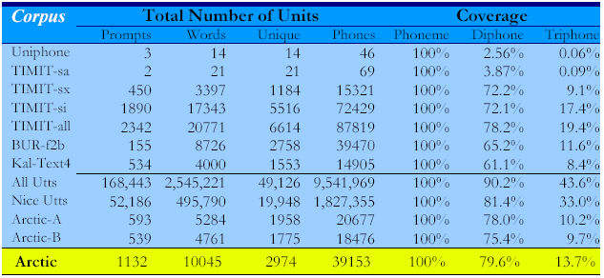
Phonetic coverage
Each units appears once and only once
Uniphone
1. “A whole joy was reaping.”
2. “But they've gone south.”
3. “You should fetch azure mike.”

Slide 23
Diphone Database collection for TTS in Romanian
Acoustic database design and implementation
  Specification of the units inventory
    SAMPA code
    Study realizations of many phones greatly on their context and position
    684 diphones
  Speech corpus
    Diphone-rich and phonetically balanced
    Rough amplitude equalization

Slide 24
Diphone Database collection for TTS in Romanian (cont.)
  Unit selection procedure and segmentation of the corpus
    Standard method: a single unit is used for each phonetic specification
      Advantage: fast to build and maintain
      Deficiency: less good output speech quality
    Dynamic unit selection: automatic unit selection
      Advantage: better speech quality
      Deficiency: require a very large corpus of natural speech

Slide 25
Diphone Database collection for TTS in Romanian (cont.)
  Three-step procedure to create Diphone database
    Reduced-size database (RDB): 684 units for each diphones
    A large-size database was built
    Extended database (EDB): 3410 units pruned with program that auto. removed too many appearances

Slide 26
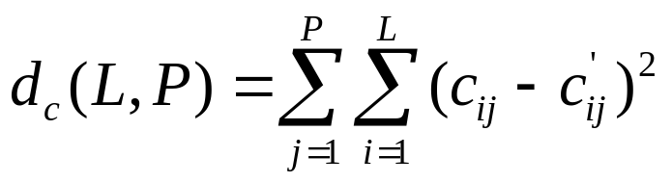
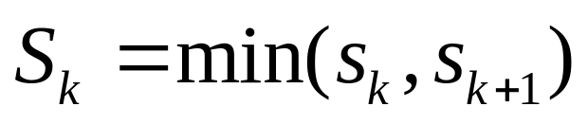
The method for spectral discontinuity in diphone database
Distance measure
Frame number decision
For each diphone k, automatically chose the most favourable diphone k+1 based on minimum spectral-distance measure

Slide 27
Evaluation experiments in diphone database
Test 1: by simple diphone concatenation with units from the RDB
Test 2: by simple diphone concatenation with units from the EDB
Test 3: by diphone concatenation using PSOLA-type algorithm with units from the RDB
Test 4: by diphone concatenation using PSOLA-type algorithm with units from the EDB

Slide 28
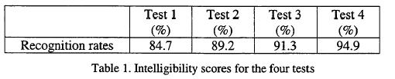
Evaluation experiments in diphone database (cont.)

Slide 29
Our TTS system future
Amplitude modulation
  Analyze the coarticulation in diphones and syllables
Design specific database for TTS
  What units will be selected
Find a better way to solve the problem of Pitch mark
  Apply Gang’s approach
Solve the discontinuity in concatenation boundaries
Multilingual text processing

Slide 30
Database labeling in Romanian[M. Boldea 1998,1997]
Speech signal transcrption
  TIMIT: labeled using a semiautomatic procedure
    Manual quasiphonemic trascription
    Automatic speech signal segmentation
    Label alignment
  HMM-based automatic segmentation and alignment [Ljolie and Riley, ICASSP’ 91] become dominant
    Usually using label networks generated automatically from orthographic transcriptions, and including pronunciation

Slide 31
Automatic alignment in Romanian[M. Boldea 1998,1997]
Train segment (phoneme and silence) HMMs iteratively
Use HMMs for a Viterbi segmentation of the signals

Slide 32
My idea
First stage
  Using TW01, MD01 and MAT2000 to build the better HMM models
  Detect the silence boundary for TW02, TW03 by noise detection
Second stage
  Using better HMM models for auto labeling TW02 and TW03 which have boundary detection
  Iteratively training segment by refined label
  Take the Iteratively training models to get more precise phone boundary

Slide 33
My idea (cont.)
Third stage
  Manual transcription by TTS component
    The auto label can be good reference
    The TTS component help to hear both reference and manual trascription

Slide 34
Recent work report
Finished
  ForSDAT
    Lab to tcp
    All speech files are transformed into wav format
      TW01, MD01: 16K 16bits PCM
      TW02:
        TEL: 8K 8bits mulaw
        MIC: 16K 16bits PCM
      TW03
        MIC: 16K 16bits PCM
  MAT2000
    Lab to Tcp, all wav format files (8K 16bits PCM), avalaible

Slide 35
Recent work report (cont.)
Update
  ForSDAT tcp vision 2.6
    Remove some waveforms whose volume is less than 1K
Ongoing
  TCC 300
  FORSDAT-TW02 data validation
  FORSDAT-TW03 data validation
  ForPA v.s. SAMPA-C inventory

Slide 36
Summary
Our TTS system have large gap in recent systems
Just initial stage in our ForSDAT!
  Not good enough to use
We shall focus ourselves on
  Better Automatic transcription methods
  Good procedure to validate speech data
  A More Creative Work is Needed!

